Slide 1
Lecture 17
Exception Handling

Slide 2
Exception Handling-Fundamentals
An exception is an abnormal condition that arises in a code sequence at run time
A Java exception is an object that describes an exceptional condition that has occurred in a piece of code
When an exceptional condition arises, an object representing that exception is created and thrown in the method that caused the error
An exception can be caught to handle it or pass it on
Exceptions can be generated by the Java run-time system, or they can be manually generated by your code

Slide 3
Exception Handling
Performing action in response to exception
Examples
Exit program (abort)
Ignore exception
Deal with exception and continue
Print error message
Request new data
Retry action

Slide 4
Representing Exceptions
Two types of Exceptions: 1. Checked Exception 2. Unchecked Exception

Slide 5
Uncaught Exceptions
class exc0{
public static void main(String args[])
{
int d=0;
int a=42/d;
}
}
A new exception object is constructed and then thrown.
This exception is caught by the default handler provided by the java runtime system.
The default handler displays a string describing the exception, prints the stack trace from the point at which the exception occurred and terminates the program.
Output:
java.lang.ArithmeticException: / by zero
at exc0.main(exc0.java:4)

Slide 6
Exception Handling in Java
Java exception handling is managed by via five keywords: try, catch, throw, throws, and finally
Program statements to monitor are contained within a try block
If an exception occurs within the try block, it is thrown
Code within catch block catch the exception and handle it

Slide 7
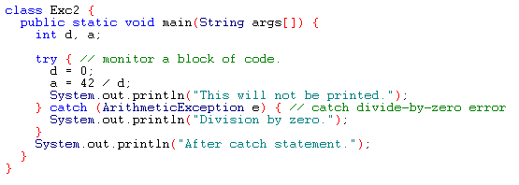
Example
Output:
Division by zero.
After catch statement.

Slide 8
try and catch statement
The scope of a catch clause is restricted to those statements specified by the immediately preceding try statement.
A catch statement cannot catch an exception thrown by another try statement.
The statements that are protected by the try must be surrounded by curly braces.

Slide 9
Multiple Catch Clauses
If more than one can occur, then we use multiple catch clauses
When an exception is thrown, each catch statement is inspected in order, and the first one whose type matches that of the exception is executed
After one catch statement executes, the others are bypassed

Slide 10
Example-Try and Catch Statements
Output:
C:\>java MultiCatch
a=0
Divide by 0: java.lang.ArithmeticException: / by zero
After try/catch blocks

Slide 11
Caution
Exception subclass must come before any of of their superclasses
A catch statement that uses a superclass will catch exceptions of that type plus any of its subclasses. So, the subclass would never be reached if it come after its superclass
For example, ArithmeticException is a subclass of Exception
Moreover, unreachable code in Java generates error

Slide 12
Example

Slide 13
Nested try Statements
A try statement can be inside the block of another try.
Each time a try statement is entered, the context of that exception is pushed on the stack
If an inner try statement does not have a catch, then the next try statement’s catch handlers are inspected for a match
If a method call within a try block has try block within it, then then it is still nested try

Slide 14
Example

Slide 15
Example
class MethNestTry
{
static void nesttry(int a){
try{
if(a==1) a=a/(a-a);
if(a==2){int c[]={1};c[42]=99;}
}catch(ArrayIndexOutOfBoundsException e)
{System.out.println(“Array Index out-of-bounds: “+e);}
}
public static void main(String args[]){
try{
int a=args.length;
int b=42/a;
System.out.println(“a=“+a);
nesttry(a);}
catch(ArithmeticException e){
System.out.println(“Divide by 0: “+e);
}
}}

